Slide 1

Computational Neuroscience
Assignment (2)
By: Momen Tarek Gaber
4221022

Slide 2

Contents
1
✔ calculating gradients for weights in a neural network in order to minimize the error between predicted and actual outputs.

Slide 3

Steps to Implement
Sigmoid Function: This is the activation function used for neurons.
Weights Initialization: Weights are initialized randomly.
Forward Propagation: Calculates outputs based on inputs and weights.

Slide 4

Steps to Implement
EEEEEerror Calculation: Determines the error of predictions.
Backpropagation: Calculates gradients and updates weights.
Training Loop: Repeats forward and backpropagation.

Slide 5
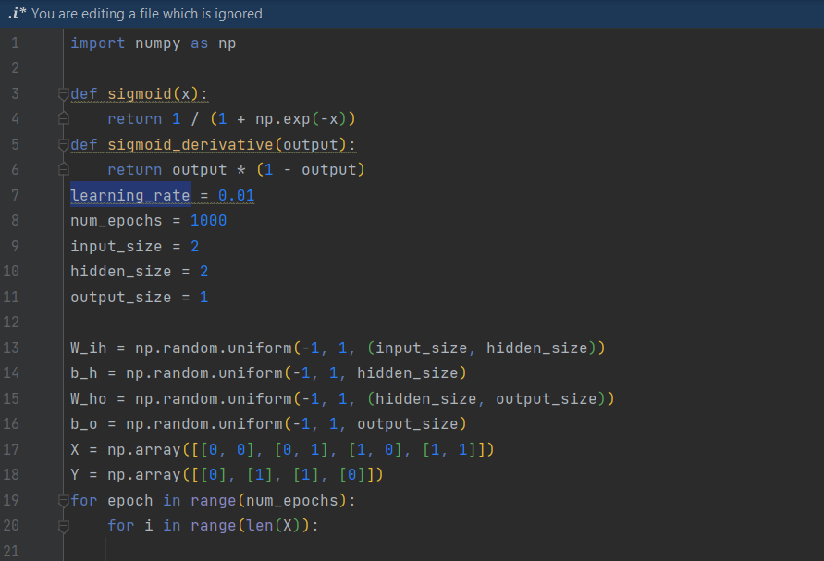

Slide 6
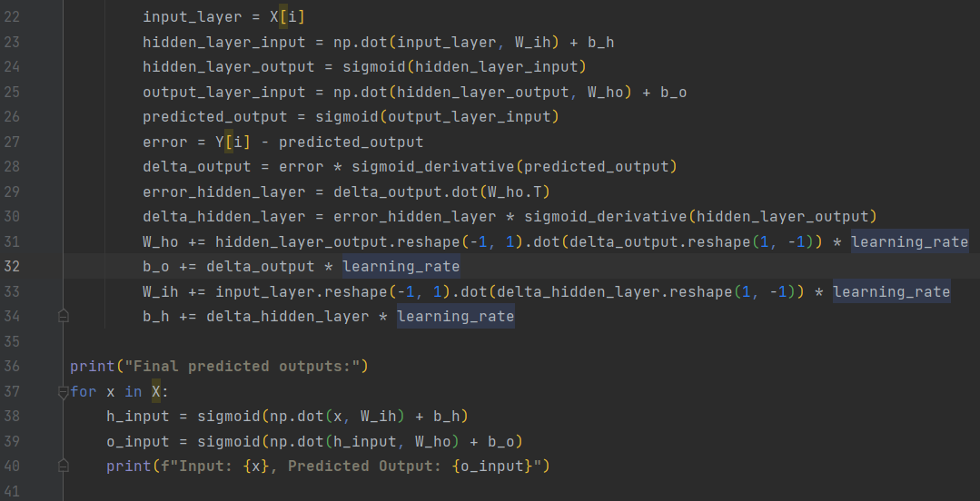

Slide 7
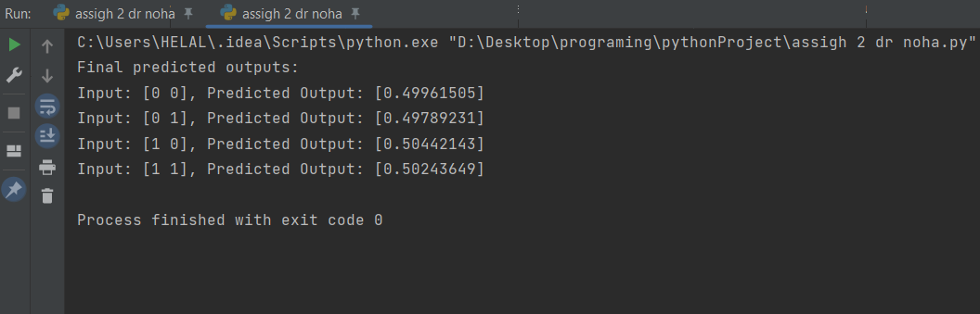

Slide 8

THANK YOU FOR LISTENING!
https://github.com/ELMOtarek1/Computational-Neuroscience-2

